Slide 1
James A Robertson and Associates
Effective Strategic Business Solutions
In Association with
Dorsa Padideh Company
Presentation to the Strategic Management Conference, Tehran, Iran
29 September 2010
ERP and IT
In Strategic Management
Dr James Robertson PrEng
Copyright 2004 through 2010
James@JamesARobertson.com
Notes:
NB remember to have a chair to stand on
Make sure to take the CRITICAL FACTORS BOOK with you
An engineer with a PhD in engineering

Slide 2
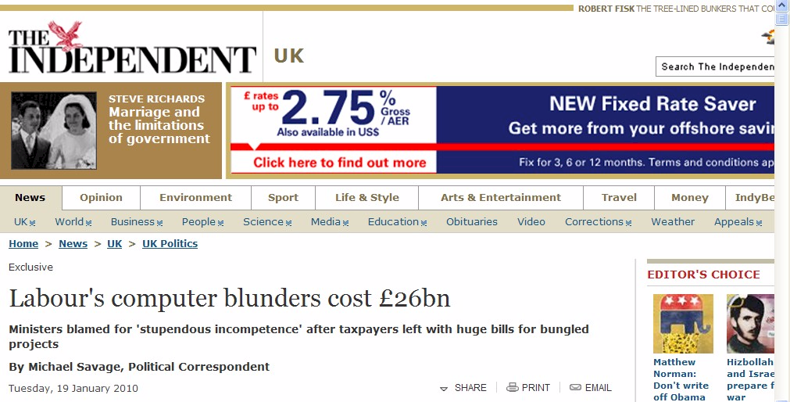
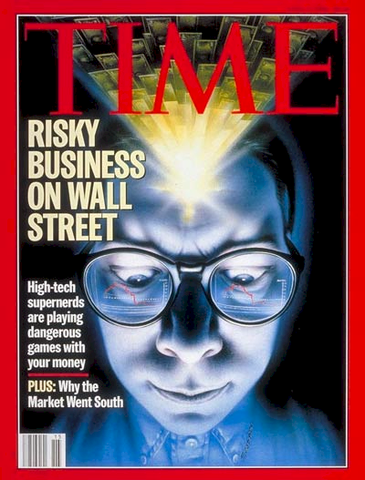
Failures are increasing
The threat and therefore the opportunity is huge

Slide 3
One of the classic business problems of this age
We have spent a FORTUNE on this computer system and I.T. tell me it will take two years and another few million to get what I want BUT the transactions are being processed already

Slide 4
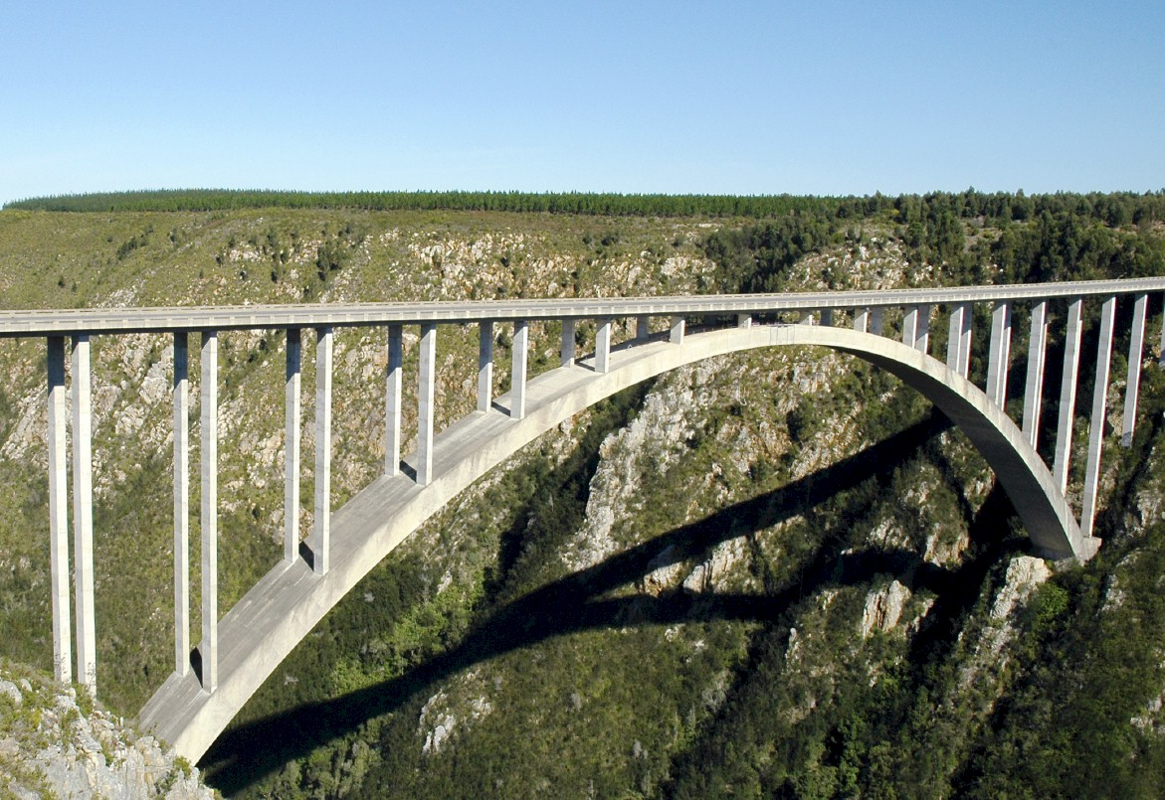
Recap
I.T. versus bridges
Notes:
In considering what i have learned as an engineer with considerable experience of the practical application of information technology i eventually realized about ten years ago that
ENGINEERS DO NOT DESIGN BRIDGES TO STAND UP – click

Slide 5
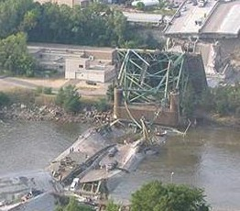
Recap
Engineers do NOT design bridges to stand up
Notes:
Who remembers this bridge collapse in Minneapolis in the middle of 2007? Within minutes it was front page news around the world – we do NOT expect bridges to fall down – if we did there would not have been anyone on that bridge that day!

Slide 6
Recap
Engineers design bridges NOT to fall down
Notes:
There is a fundamental difference in approach when one designs a bridge NOT TO FALL DOWN
Contrast this with the IT paradigm which could be called “designed to fail”

Slide 7
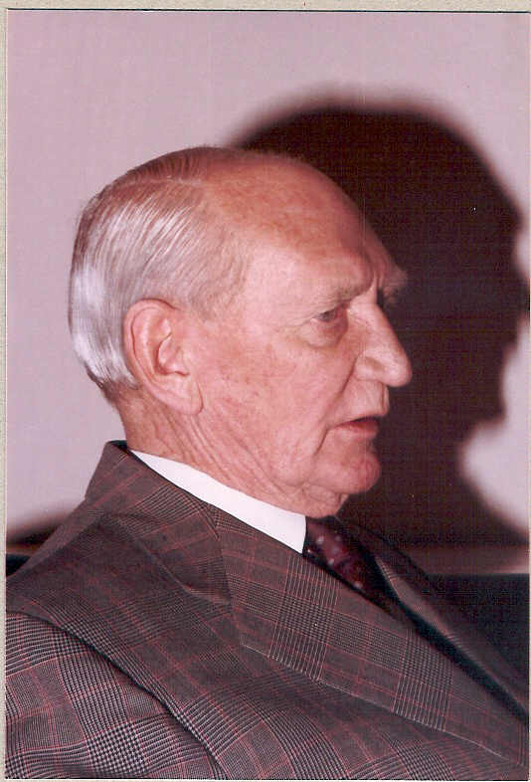
Vision
Angus Struan Robertson
Notes:
KEEP SHORT AND SIMPLE
MY FATHER
How did i get involved with computers? – my father was a visionary -- In 1981, having gathered over 7,000 pages of research data for my PhD the University mainframe did not have space to store even one page of data. My father purchased me one of the first desktop PC’s in the days of the Apple and Apricot and 123, etc – at a cost of R12,000 two and a half times my research grants! – I very quickly discovered that there was a HUGE gap between what the salesman told me the computer could do and getting it to do it – so, in that respect, NOTHING HAS CHANGED ☺ -- I then put myself through a self taught computer science programme and learned to program, learned to type and finally wrote an award winning PhD thesis – at the same time I computerized my father’s investment consulting business and we were able to double turnover in twelve months and create an enduring revenue stream that lasted for over ten years because we were able to do things that much larger businesses were not able to do – it was then that I began to understand that the strategic application of information technology COULD deliver great value and one of my greatest frustrations is the extent to which few businesses achieve this potential – the rest of this presentation is about lessons I have learned that I hope will help YOU to make a difference in your business with IT

Slide 8
A classic example of IT strategic value -- double turnover in 12 months
I am successful because I make the right recommendations more than 51% of the time
Simple manual models were computerized
Computed faster and therefore many more scenarios
Creative business concept
Better advice in less time to more clients
Doubled turnover in 12 months
In 1982

Slide 9
Experiencing failure

Slide 10
Some historical context
Insects and butterflies
Cataloguing -- punch cards
Defence Force filing system
Strategy development
ERP and other IT projects which produced exceptional outcomes
Pulse measurements on many highly sub-optimal ERP and other implementations
Some heavy opposition
and some in-depth analysis
Notes:
KEEP SHORT AND SIMPLE
MY FATHER
How did i get involved with computers? – my father was a visionary -- In 1981, having gathered over 7,000 pages of research data for my PhD the University mainframe did not have space to store even one page of data. My father purchased me one of the first desktop PC’s in the days of the Apple and Apricot and 123, etc – at a cost of R12,000 two and a half times my research grants! – I very quickly discovered that there was a HUGE gap between what the salesman told me the computer could do and getting it to do it – so, in that respect, NOTHING HAS CHANGED ☺ -- I then put myself through a self taught computer science programme and learned to program, learned to type and finally wrote an award winning PhD thesis – at the same time I computerized my father’s investment consulting business and we were able to double turnover in twelve months and create an enduring revenue stream that lasted for over ten years because we were able to do things that much larger businesses were not able to do – it was then that I began to understand that the strategic application of information technology COULD deliver great value and one of my greatest frustrations is the extent to which few businesses achieve this potential – the rest of this presentation is about lessons I have learned that I hope will help YOU to make a difference in your business with IT

Slide 11
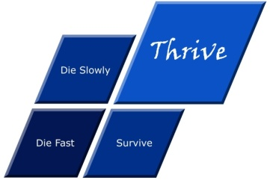
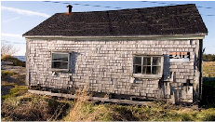
What is strategy?
Recap
Die fast
Thrive
Tactics – Doing things right ➔
Die slowly
Survive
Strategy – Doing the right things ➔

Slide 12
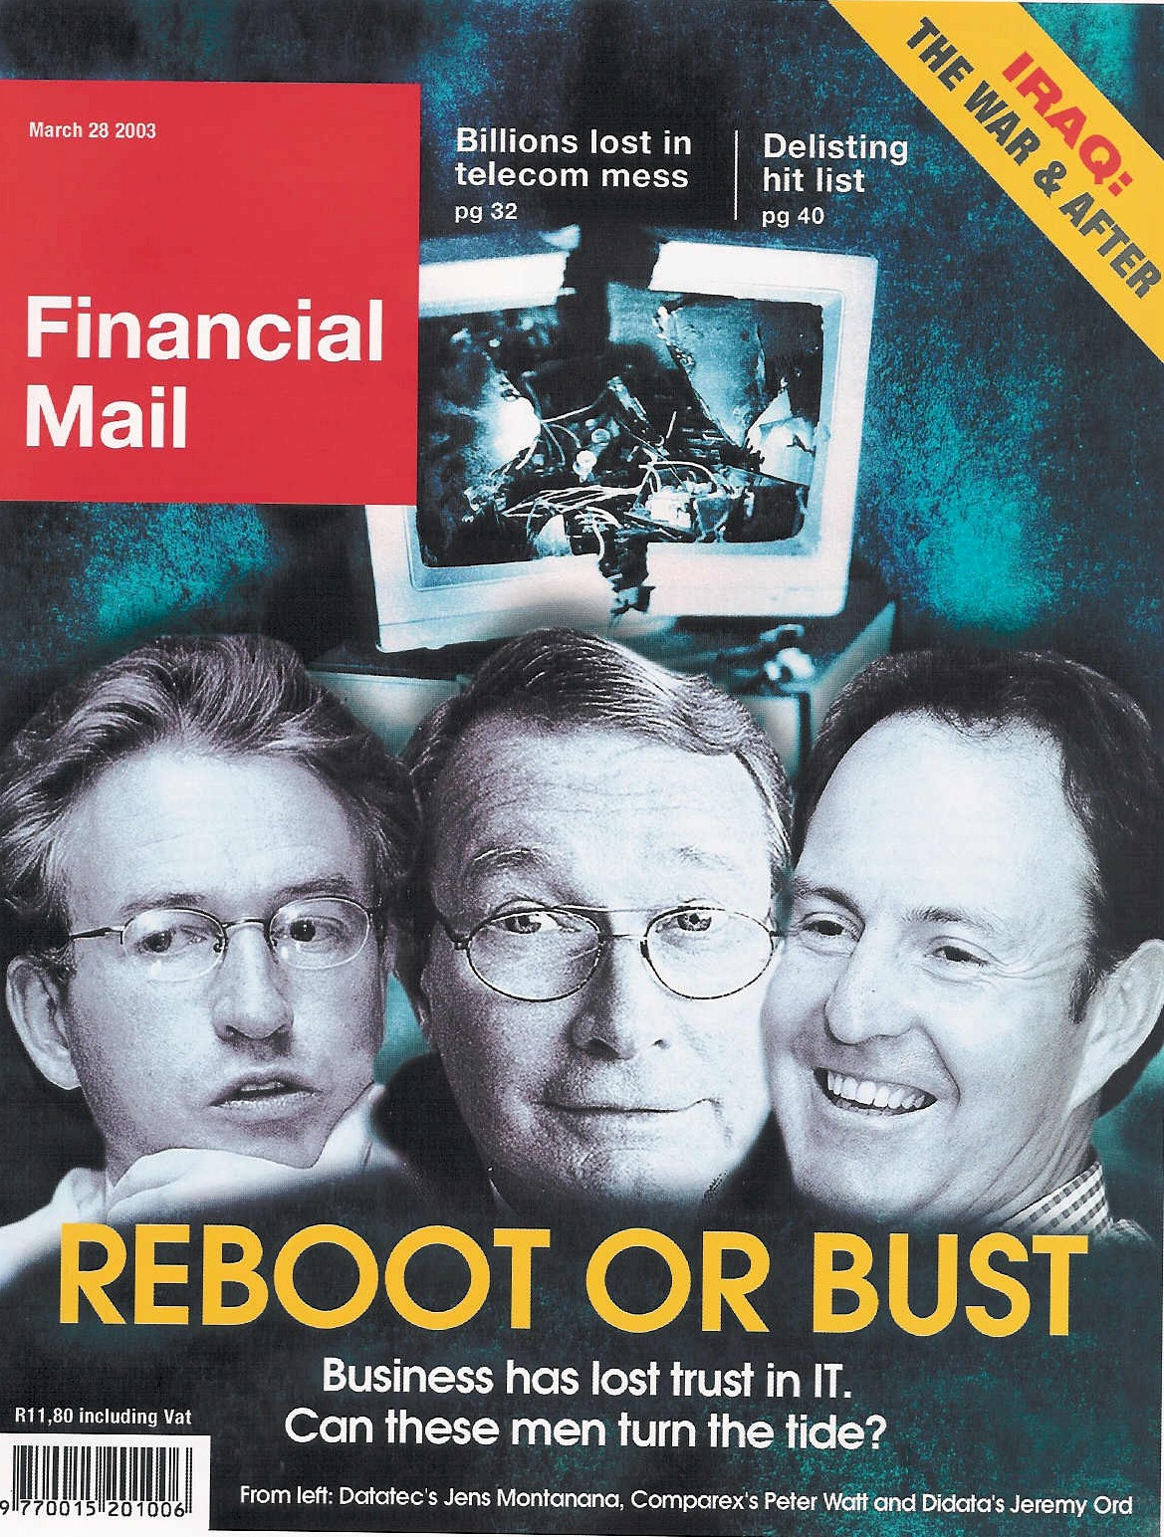
ERP an industry in crisis
“19 out of 20 ERP (integrated business information system) implementations do NOT deliver what was promised”
Notes:
An industry in Crisis -- Quote from Duncan McLeod, Financial Mail, 28 March 2008 -- Seven years and half a billion dollars -- Dow Chemicals Company -- $400 million – Nike -- Disney -- $878 million
-- 70% of business IT projects fail outright – another 20% materially fail to meet the business expectation – 70% of BPR projects fail and 90% of strategic plans fail to deliver

Slide 13
Extreme failures
Seven years and half a billion dollars -- international chemicals company
$400 million -- multinational shoe corporation
Multinational entertainment giant -- $878 million
Major supermarket chain -- $195 million
Professor Rossouw von Solms

Slide 14
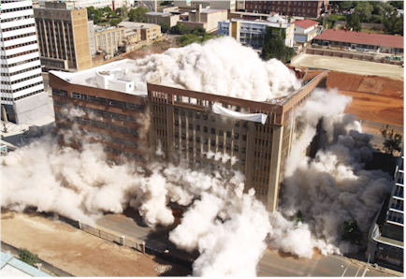
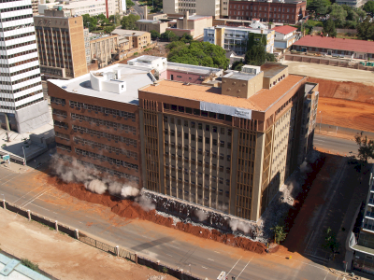
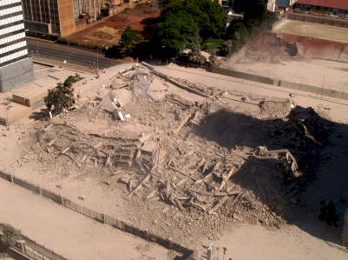
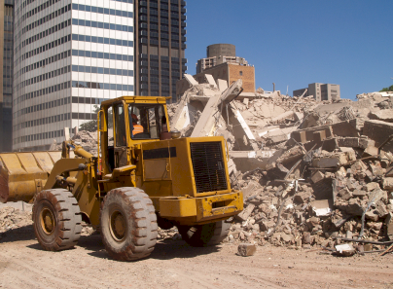
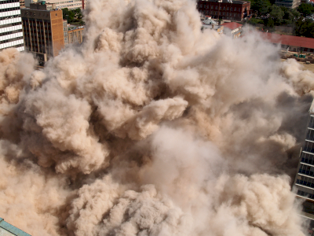
vs Deleting a building
Notes:
DHL, Prochem,

Slide 15
An industry characterized by failure
"Attendees of Gartner's Business Intelligence Summit in London last month were not surprised to hear that most enterprises are still failing to use business intelligence (BI) strategically. Gartner's survey of over 1300 CIOs returned some unimpressive findings about the state of BI implementations: Gartner's vice: president of research summed up the situation nicely by saying:
“Most organisations are not making better decisions than they did five years ago”
BUSINESS INTELLIGENCE
Article published in Computer Business Review Africa.

Slide 16
There IS great opportunity
ERP can and should add value
Notes:
Professor Richard Nolan states that "I.T. is the next corporate disaster waiting to happen”
And postulates that soon there will be an Enron level corporate failure
Do you remember Fedsure Health – tell the story SHORT

Slide 17
Different view of ERP / IBIS
(Integrated business information systems)
Real potential of ERP software
–
with high quality taxonomies
10
The REAL opportunity
–
strategic implementation
10
X 7
Common view of “best practice”
10
X 3
0
0
0
Notes:
DHL, Prochem,

Slide 18
Recap
An engineering approach to Strategy
Key points from yesterday’s presentation

Slide 19
Recap

Slide 20
Recap
Requires appropriately implemented ERP / IBIS

Slide 21
Recap
Defines the configuration framework for EVERY MODULE of ERP

Slide 22
Recap

Slide 23
Case study
Strategically successful ERP implementations
Key points from conference presentations
Based on white papers with the clients

Slide 24
Data engineering principles
Case study
Presented with the client at a public conference
Dramatic increase in management information
Reduction in head count
Dramatic reduction in audit time and cost
Unqualified balance sheet first time in 15 years

Slide 29
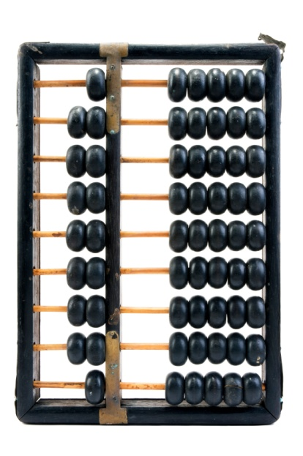
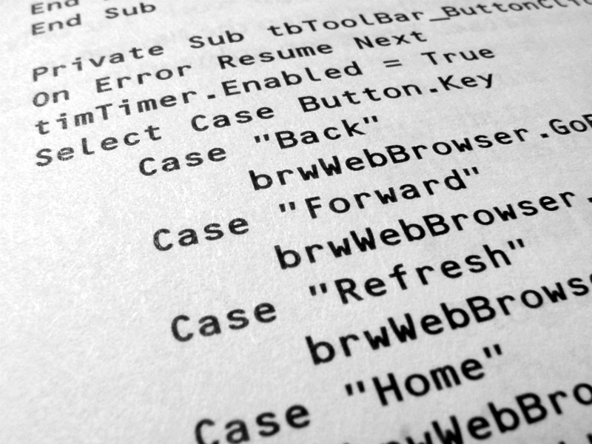
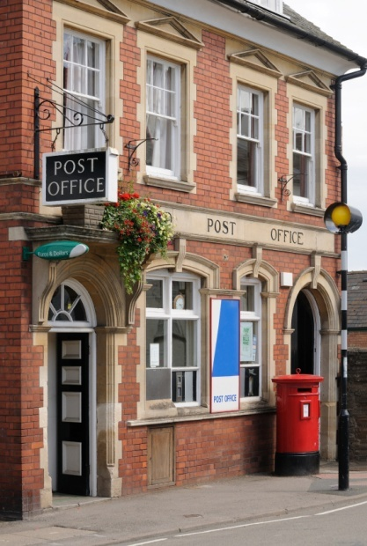
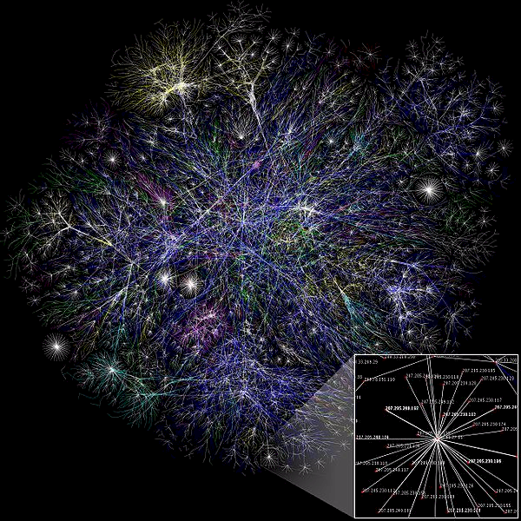
What is IT?
REALLY?
$
Notes:
You understand the technology well enough to manage it
VERSUS ABDICATION / DISEMPOWERMENT
FAST
Computers are simply adding machines or switches that switch left or right – 0 or 1 – on or off – called binary – they just do things very quickly, everything you see is a pattern of 0’s and 1’s – a very fast Abacus – the content is always the same – binary code -- source code is simply instructions for the bricklayer
Wordprocessors are typewriters -- The typing story – so why do you want to spend thousands of Rands upgrading your typewriter every few years? -- Databases are filing cabinets or warehouses -- General ledgers are large books that book keepers write in – networks are postal systems – large frame pictures cost a lot and take up lots of space

Slide 30
What is an ERP?
REALLY?

Slide 31
What is an ERP?
“Enterprise Resource Planning” = ERP Systems
? or ?
"Integrated Business Information Systems” = IBIS
= all the information “repositories”
= databases
= tables
= lists
= filing drawers / folders
real world items that require description and management
+ the numerical computations, workflow and other activities that are executed with the numbers (and text) stored in these repositories
ALL of which can be done by human beings -- including making a mess!

Slide 32
Why invest in a new ERP / IBIS? Or any IBIS?
1. Because everyone else has one?
2. Because the one we have does not work very well?
3. Because the one we have is more than five years old?
4. So that we can get better strategic (thrive) information?
5. So that we can get better tactical (thrive) information?
6. So that we can get better operational (thrive) information?
7. So that we have more effective delegation and governance?
8. So that we can become more efficient?
9. Head count reduction and audit fee reduction?
? X No
? X No
XXX NO!!!
Yes
Yes
Yes
Spinoff
Spinoff
Spinoff
To support better decision making

Slide 33
How do you unlock IBIS value?
Value is unlocked through effective delivery of information that is intuitively fundamentally meaningful
Packaged in a way that the computer system APPEARS to be intelligent
Presented through:
reports
graphs
dashboards
advanced statistical techniques
advanced economic analysis
other advanced techniques of information presentation, analysis and interpretation
Resulting in MUCH BETTER strategic, tactical and operational decisions that manifest in improved organizational profitability, growth, impact, etc
High value business decisions

Slide 34
What is the core requirement for any IBIS?
I can get answers to any question for which I can reasonably expect there to be answers in the databases that I KNOW my organization has
Easily and quickly and without major effort on the part of any staff member or contractor
The RIGHT information at the RIGHT place at the RIGHT time in order to make the RIGHT decision
High value intelligent information

Slide 35
How is value created
Value is created by business actions that deliver on the essence of why the organization exists and how it thrives
Value manifests through increased profitability, growth, acquisitions, job satisfaction, fulfilment of the strategic vision
The consequence of intuitive, intelligent, informed leadership business decisions – thrive decisions
Such decisions are facilitated, accelerated and enhanced through access to more intelligent, meaningful and relevant information
Answers to the questions I have not yet thought to ask
Such “intelligent information” is assembled as a consequence of high level strategic and executive level input into the design of the data CONTENT – taxonomies designed to catalogue every conceivably relevant classification ahead of time
High value intelligent content design

Slide 36
Precision strategic content engineering
The definition of information content
in a way that is structurally (taxonomically) fundamentally meaningful to human beings who understand the business
and the translation of this content into structured codes which faithfully and accurately reflect human understanding of the REAL WORLD in a way that the computer can manipulate
with minimal human intervention
so that the computer system appears to be intelligent

Slide 37
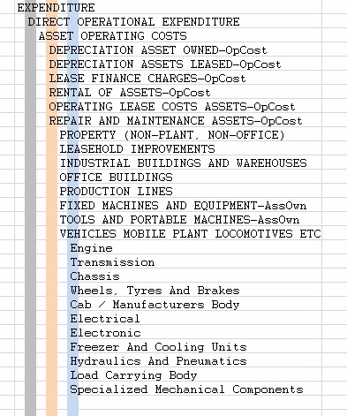
Taxonomy defined
Logical word (semantic structure)
Precision vocabulary of preferred terms
Conveys understanding between humans with relevant knowledge and experience
Once linked to a precision code scheme the most important communication mechanism between computers and people
An art and a science
Once it is right it is OBVIOUS ☺

Slide 38
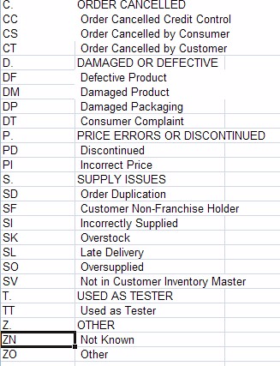
Taxonomy relevance
Essential to effective operational and strategic use of business software
Nearly ALL validation lists (drop down lists), chart of accounts, etc
Large body of expertise – Botany, Zoology, military filing, Library Science, Information Management, etc
Unknown to many (most?) IT professionals and business people

Slide 39
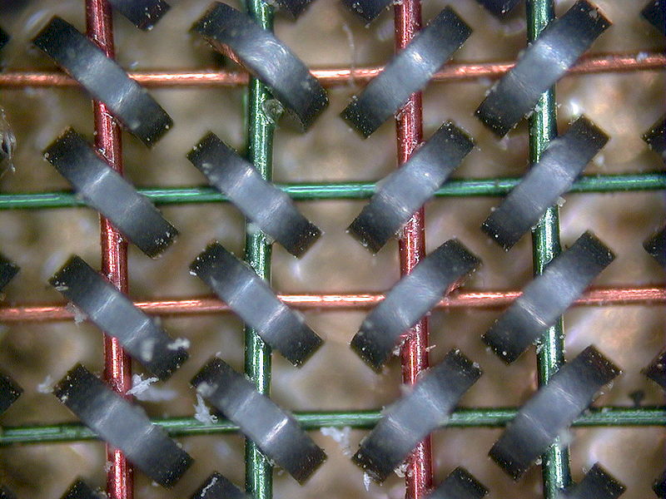
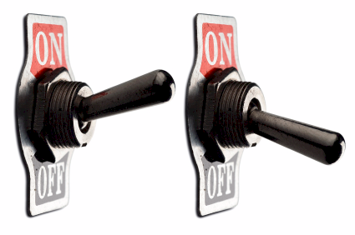
A computer is
An adding machine / calculator
0
1
1+1=10
1+1+1=11
1+1+1+1=100
Called a “bit”
8 bits make a byte
2 bytes make an ASCII character
A= “41” hex
0
1
Notes:
DHL, Prochem,

Slide 40
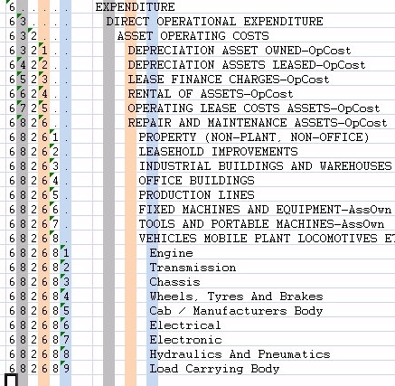
Coding taxonomies
Computers only understand binary
The code is a unique binary pattern that corresponds to the structured language taxonomy
The only way the computer will appear to be intelligent
Results in “intelligent data”
Standard conventions
Indents and trailing periods
2. Capitalization
3. Other standards and conventions

Slide 41
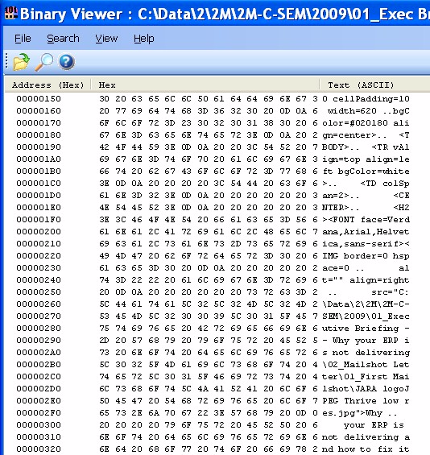
Software and data
text -> hexadecimal -> binary
All for US ☺
Notes:
DHL, Prochem,

Slide 42
What is a general ledger?
Notes:
You understand the technology well enough to manage it
VERSUS ABDICATION / DISEMPOWERMENT
FAST
Computers are simply adding machines or switches that switch left or right – 0 or 1 – on or off – called binary – they just do things very quickly, everything you see is a pattern of 0’s and 1’s – a very fast Abacus – the content is always the same – binary code -- source code is simply instructions for the bricklayer
Wordprocessors are typewriters -- The typing story – so why do you want to spend thousands of Rands upgrading your typewriter every few years? -- Databases are filing cabinets or warehouses -- General ledgers are large books that book keepers write in – networks are postal systems – large frame pictures cost a lot and take up lots of space

Slide 43
Integrated system
(look-up and posting)
Plant
Management
Projects
Inventory
Production Planning
Human Resources
General Ledger
Etc, etc, etc
Asset Register
Accounts Payable
Cash Book
Accounts Receivable
Financial amounts R / $/ etc
People related names, rates, etc
Production related shifts, batches, etc
Notes:
You understand the technology well enough to manage it
VERSUS ABDICATION / DISEMPOWERMENT
FAST
Computers are simply adding machines or switches that switch left or right – 0 or 1 – on or off – called binary – they just do things very quickly, everything you see is a pattern of 0’s and 1’s – a very fast Abacus – the content is always the same – binary code -- source code is simply instructions for the bricklayer
Wordprocessors are typewriters -- The typing story – so why do you want to spend thousands of Rands upgrading your typewriter every few years? -- Databases are filing cabinets or warehouses -- General ledgers are large books that book keepers write in – networks are postal systems – large frame pictures cost a lot and take up lots of space

Slide 44
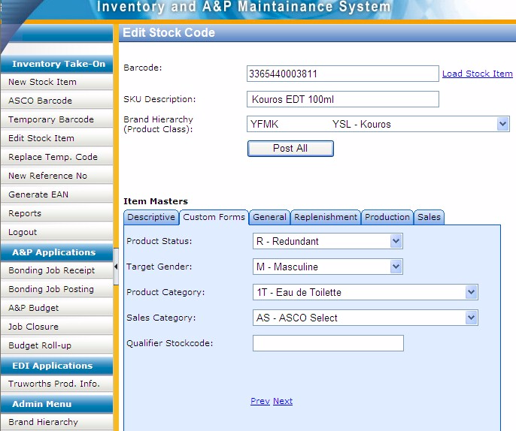
Example of custom data entry screen
With custom taxonomies
Notes:
DHL, Prochem,

Slide 45
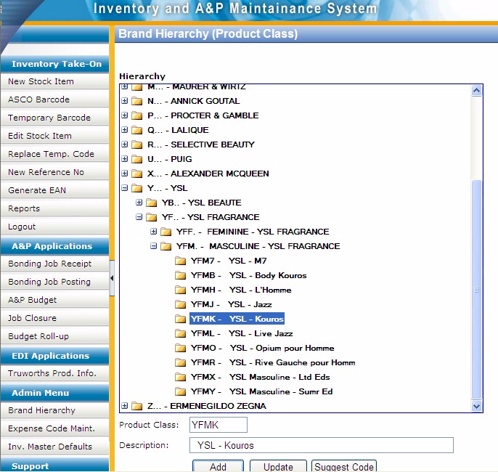
Example of custom code maintenance development for client specific taxonomy
Notes:
DHL, Prochem,

Slide 46
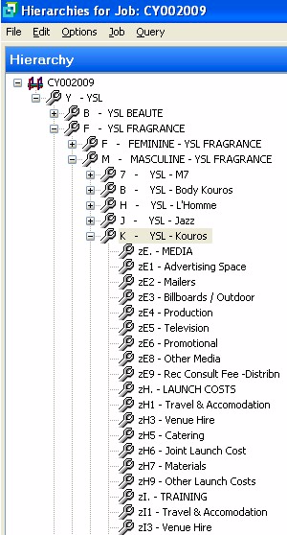
Matching codes in unrelated module provide logical integration
Getting the software to do what it supposedly cannot do
Notes:
DHL, Prochem,

Slide 47
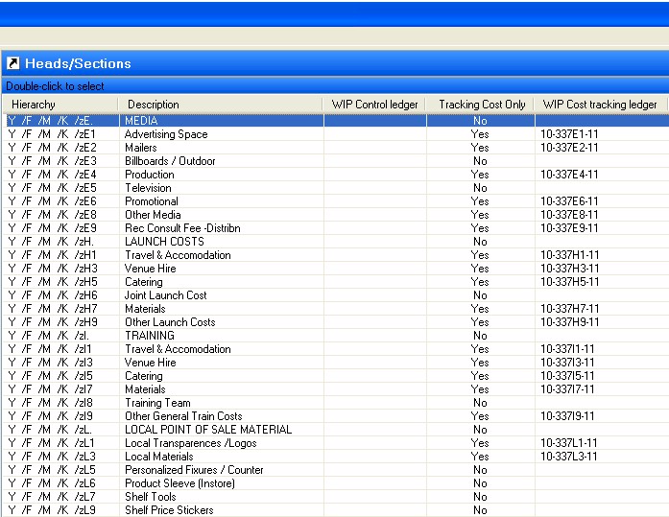
Example of faulty integration
“The &$%^#@% system lost my data”
Notes:
DHL, Prochem,

Slide 48
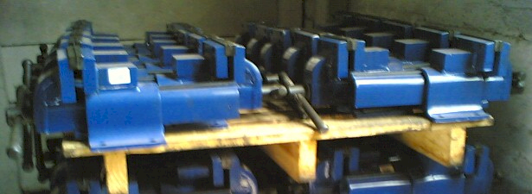
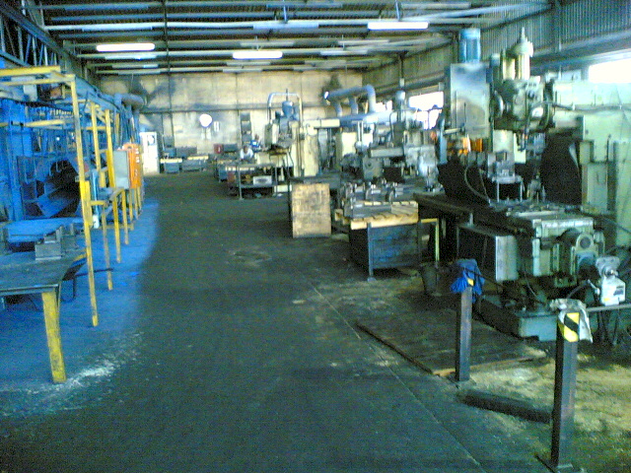
So….
What is an ERP?
REALLY?
Notes:
DHL, Prochem,

Slide 49
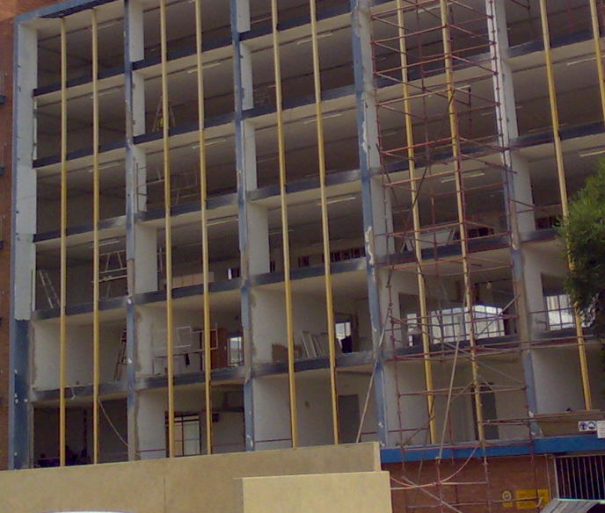
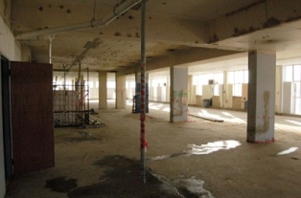
Delete (scrap) or refurbish?
Notes:
DHL, Prochem,

Slide 50
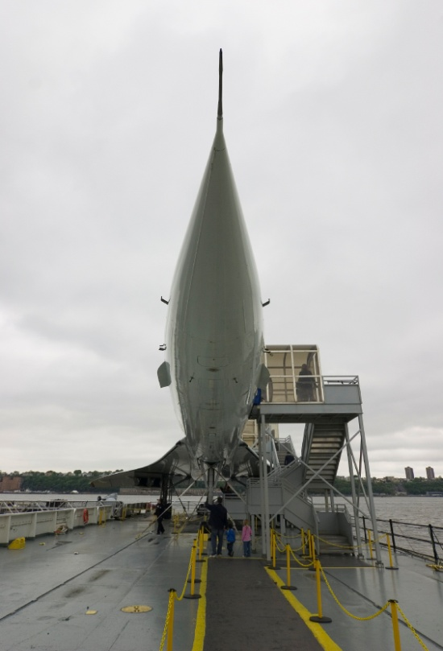
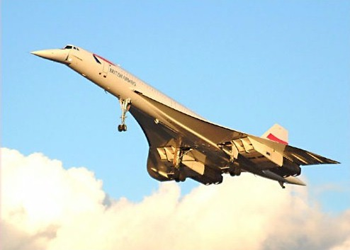
Is IT moving so fast you cannot keep up?
Notes:
Lancaster 1941 – 1 still flying 2008
747 1969 – still flying and new models still being made
Concorde 1969 – 2006 ? Last flight
You CAN keep up with technology
Make technology slow down to the pace that suits your business
Relevant technology that works
GESTURES
Do you remember the Concorde? – Johannesburg to London in three hours? – BUT the people on the ground were not prepared to tolerate the BOOMMMMMMMMMMM as the plane travelled at supersonic speed so it never took off commercially, only 20 were built and one crashed owing to a design flaw and the last planes today are sitting in museums
Then there was the Boeing 747 – designed almost by accident – tell the story
So, is IT moving so fast – not really – the big question is whether Windows Vista is the Concorde of IT

Slide 51
Factors causing ERP failure
Weak content engineering is the most tangible factor causing failure

Slide 52
The value of technology is determined by the person using the technology
Notes:
A gun is neither good nor bad
If it is held by a person you regard as good and pointed at a person you regard as bad the gun is good
BUT if it is pointed at YOU it is always BAD!

Slide 53
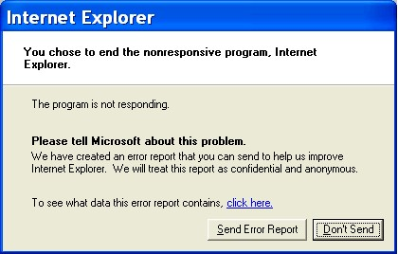
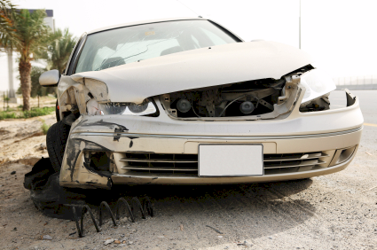
Technology is only 5% of what causes failure
Software defects CAN be prevented
Take a stand
Notes:
A gun is neither good nor bad
If it is held by a person you regard as good and pointed at a person you regard as bad the gun is good
BUT if it is pointed at YOU it is always BAD!

Slide 54
IT people who lie

Slide 55
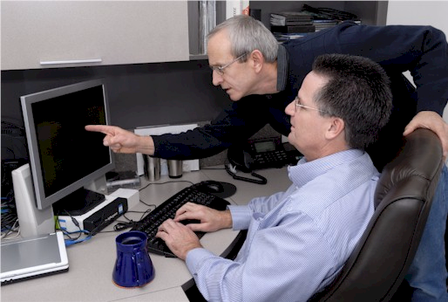
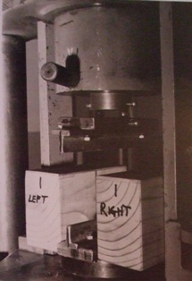
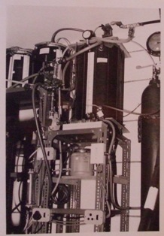
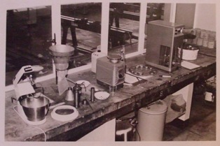
Laboratory
A location where the real world is simulated on a statistically valid representative basis
ALL possible scenarios thoroughly tested
Notes:
DHL, Prochem,

Slide 56
The Business Intelligence
and ERP challenge
Most businesses are NOT making better decisions than they did five years ago despite substantial BI investments -- Gartner 2006
19 out of 20 ERP implementations do not deliver what was promised” – Financial Mail 2003
50% of ERP projects fail – Gartner
Precision strategic content engineering
→ THE MISSING LINK
A HUGE OPPORTUNITY

Slide 57
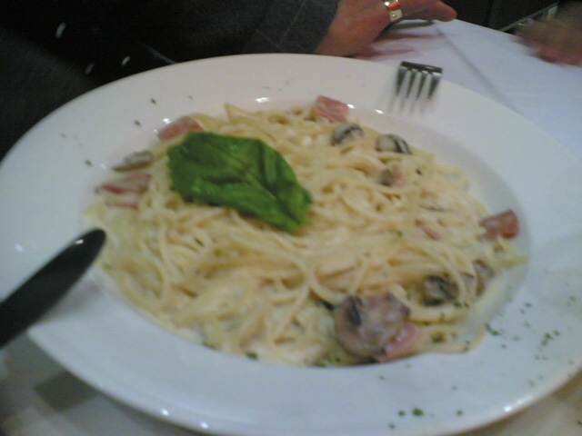
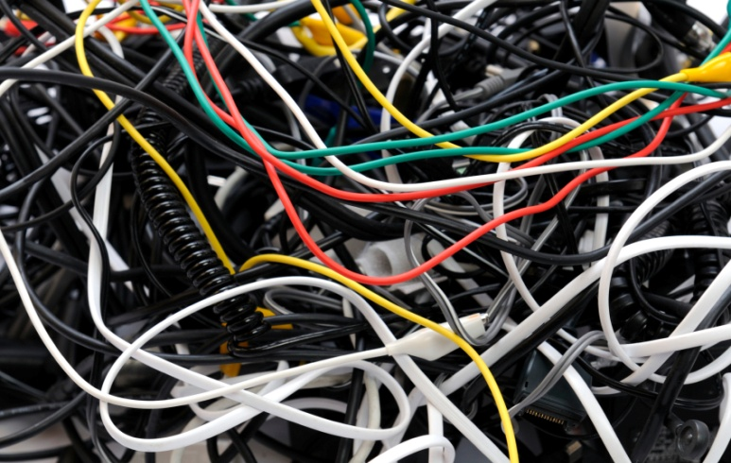
Example of exceptionally BAD practice
Huge impact on integration, reporting, etc
500528 | Waste Material Consumed
500530 | Loss from valuation of external materials
500540 | Loss from valuation of own materials
500550 | Losses - inventory variance -consignment sale
500560 | Safety Clothing
500565 | Safety Equipment
500570 | Sand & Stone
500575 | Scraper Rope
500580 | Scrapers
500585 | Services
500590 | Signs
500595 | Skips & Cages
500600 | Finished Goods Inventory Offset
500605 | Smelting & Refining
500610 | Production Order Settlement - Variance
500615 | Steel Other
500620 | Steel Sections
500625 | Steel Sheets & Plates

Slide 58
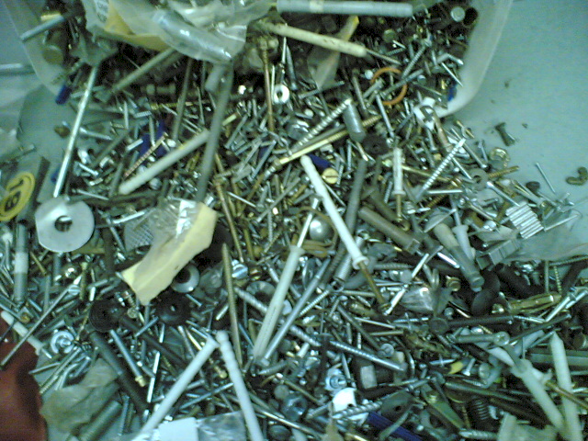
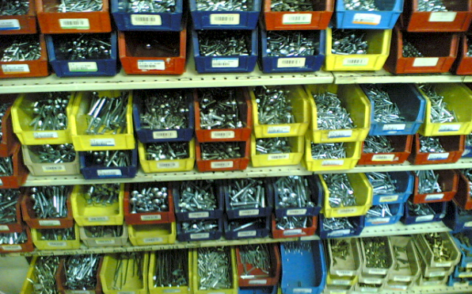
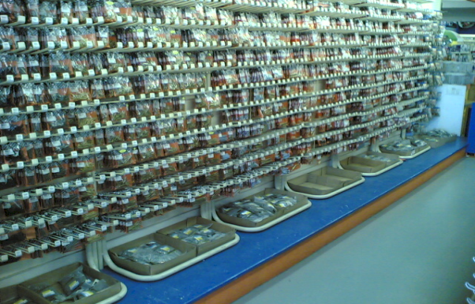
Precision ordered data
Versus …

Slide 59
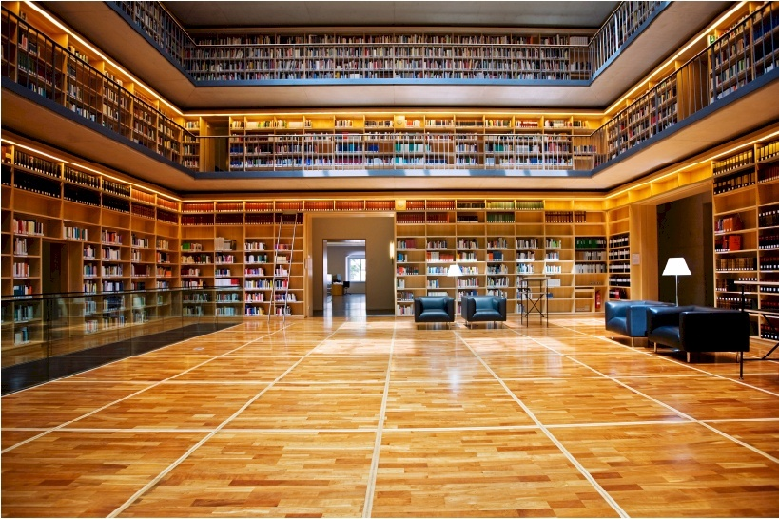
From chaos to order
Example of simple hierarchically structured data table

Slide 60
What is the best way to unscramble spaghetti?
Do NOT scramble it in the first place!

Slide 61
Structure of strategically aligned Chart of Accounts → plant maintenance → inventory → etc
Most strategic components
Assets
Assets owned
Assets leased
...
Dep’n assets owned
Dep’n assets leased
...
Liabilities
Income
Expenses
R&M assets
Finance and insurance
assets
...
Plant Maintenance
Materials Management
Investment
Exploration
Development
Mine operation
Processing
Marketing and sales
Operational support
Administration
Dividends, taxes, etc
MOBILE PLANT
LHD’s
Dump trucks
Drill rigs
Other off road
LDV’s
etc
Provide for foreseeable growth
Five to ten years
Least strategic components

Slide 62
Mapping between modules
Well structured
GL R&M spares expenses
MM plant spares
MOBILE PLANT
Loaders
Dump trucks
Drill rigs
Other off road
LDV’s
etc
MOBILE PLANT
Loaders
Dump trucks
Drill rigs
Other off road
LDV’s
etc

Slide 63
Value versus precision
A critical consideration
The goal
100%
Business value delivered
Just about every implementation I have ever seen
Practical fundamental strategic taxonomy precision
100%

Slide 64
Critical principle – constraint and opportunity -- cognitive span
Strategically determined (thrive) segmentation

Slide 65
Drill down
A function of the content
Strategically determined (thrive) segmentation

Slide 66
Longevity of the scenarios
Formal best practice data engineering
Mapping within current constrains
Notes:
Been doing for 20 years, done dozens

Slide 67
Characteristics of precision strategic content engineering
Methods and standards
Driven by executive (strategic) decision support requirements
Fundamental first principles → Strategic
Highly structured → Hierarchical
Very specific coding and layout conventions for ease of use
Disciplined code design and maintenance
Massive improvement in management information and decision support
Deliver the often promised but seldom delivered benefits of business ERP, CRM, ECM, BI, IT → business system investments
An opportunity to gear your current investment

Slide 68
Factors for ERP reimplementation success
Strong content engineering is the most tangible factor for success

Slide 69
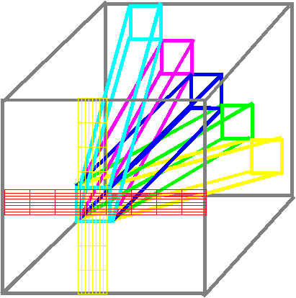
Cubic business model
Locus of integration -- taxonomies
Accounts in the Ledger
Other modules

Slide 70
How integration works around the GL
Other modules

Slide 71
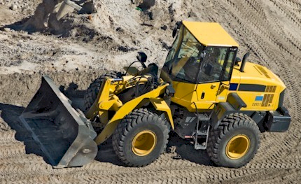
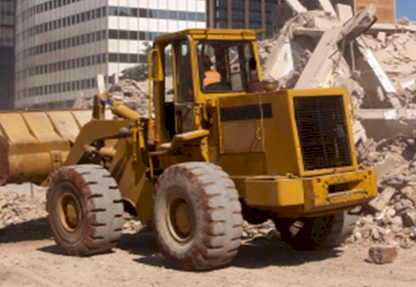
If only I knew exactly what the relative cost of these two machines was I could compete more profitably
Benefits of a comprehensive integrated intelligent information model
Comprehensive integrated economic and operational model
with precision strategic taxonomies
GL
MM
IM
PM
PC
etc
Precision fundamental strategic taxonomies

Slide 72
Summing up
Better DECISIONS
Excellent high value decisions rely on logical strategically aligned information → the information to thrive
To get executive intelligence OUT you must put executive intelligence IN – “intelligent content”
Precision strategic content engineering IS THE missing link in ERP and IBIS
Requires a significant investment – an ART and a science
Comprehensive strategic analysis is a pre-requisite for a high quality ERP implementation
Corporate strategic capability must be developed as part of an ERP project if it does not exist
A huge opportunity

Slide 73
If you do not act within 48 hours you probably never will – act TODAY! ☺
What is your single most important insight from this presentation?
What is the single most practical action that you can take tomorrow to apply I.T. more effectively?
James@JamesARobertson.com
Strategicmanagement.ir@Gmail.com

Slide 74
Design IT and ERP solutions like bridges
Not to fall down – intelligent STRATEGIC content

Slide 75
Acknowledgements
Clients, associates, staff
Loraine who lights up my life
Father and mother, Angus and Thelma
Children Alexandra and Struan
Other significant people in my life
"To Him who by wisdom made the heavens, for His mercy endures forever;"

Slide 76
Questions?
Dr James Robertson PrEng
James A Robertson & Associates
James@JamesARobertson.com
Represented in Iran by
The Dorsa Padideh Company
Mr Masoud Aslani
Strategicmanagement.ir@Gmail.com
Finding the missing pieces of your ERP and strategy puzzles

